Slide 1
Microbial Community analysis
Erick Cardenas Poire
University of British Columbia

Slide 2
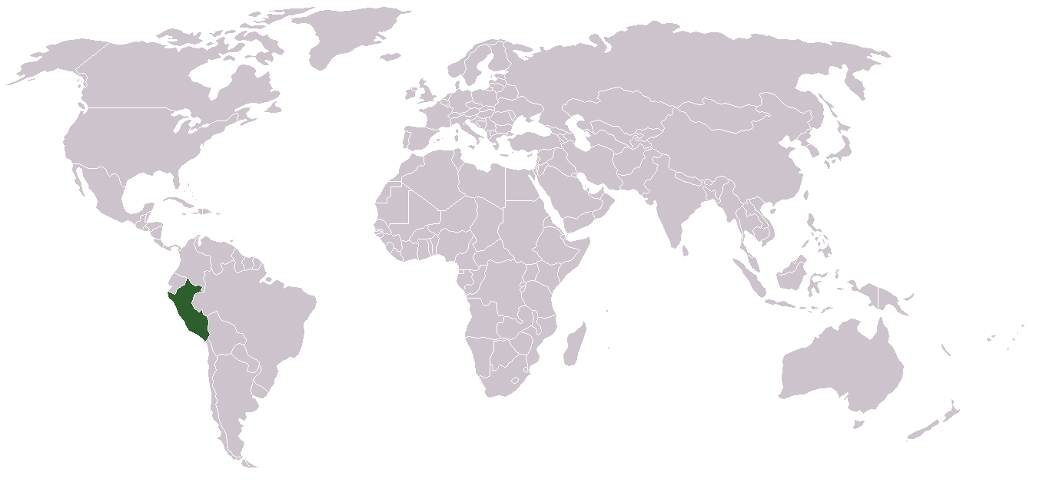
Who I am ?

Slide 3
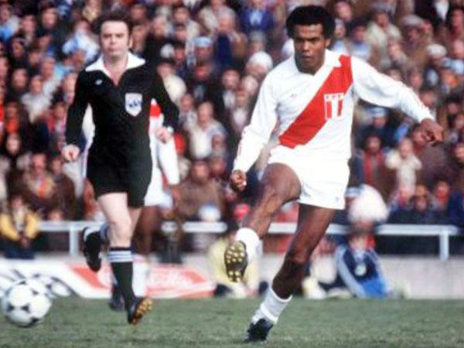

Slide 4
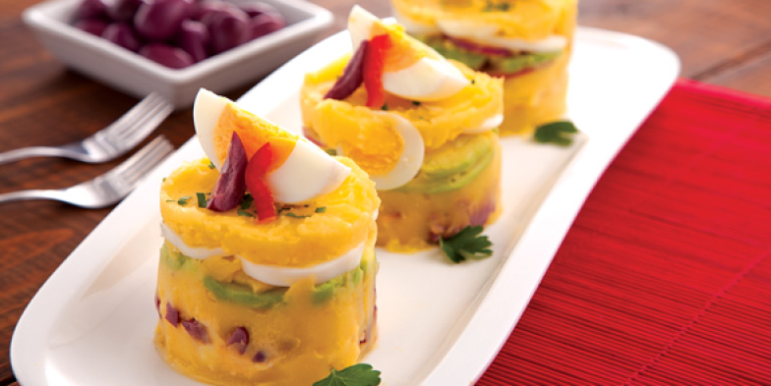

Slide 5
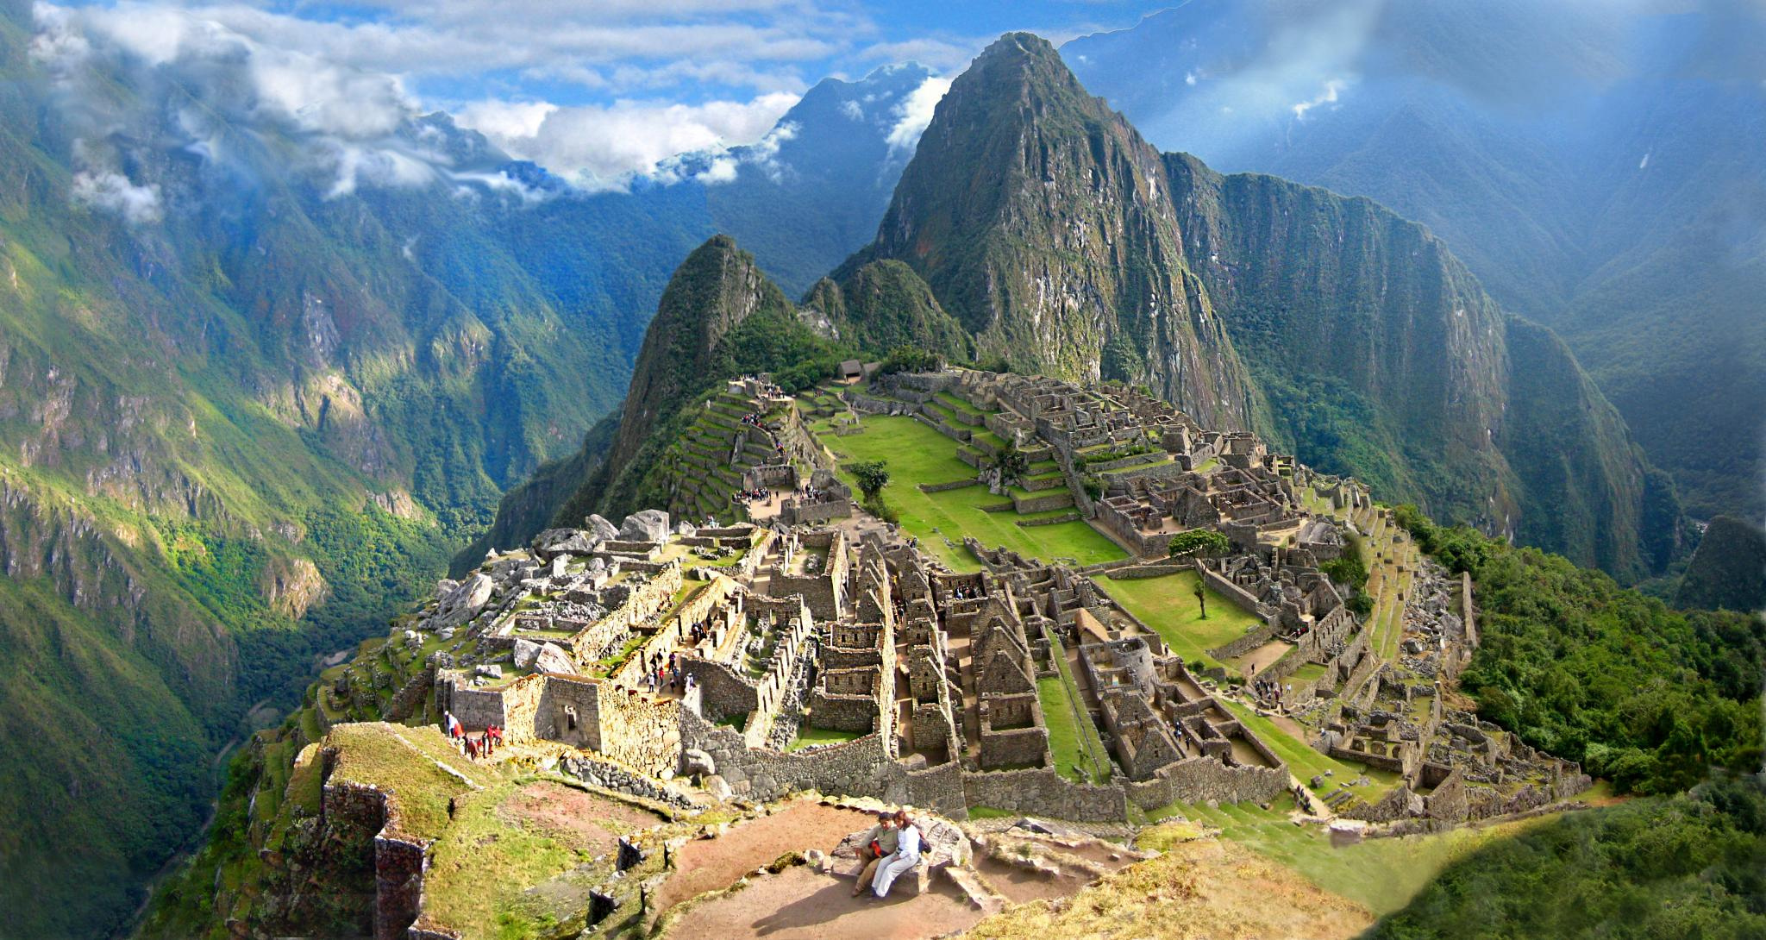
Macchu Picchu
See it before it gets ruined!

Slide 6
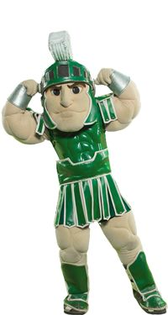
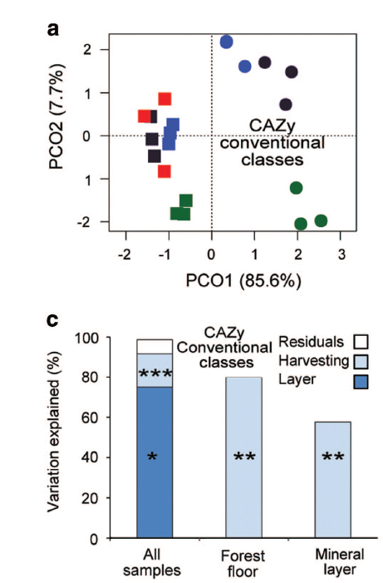
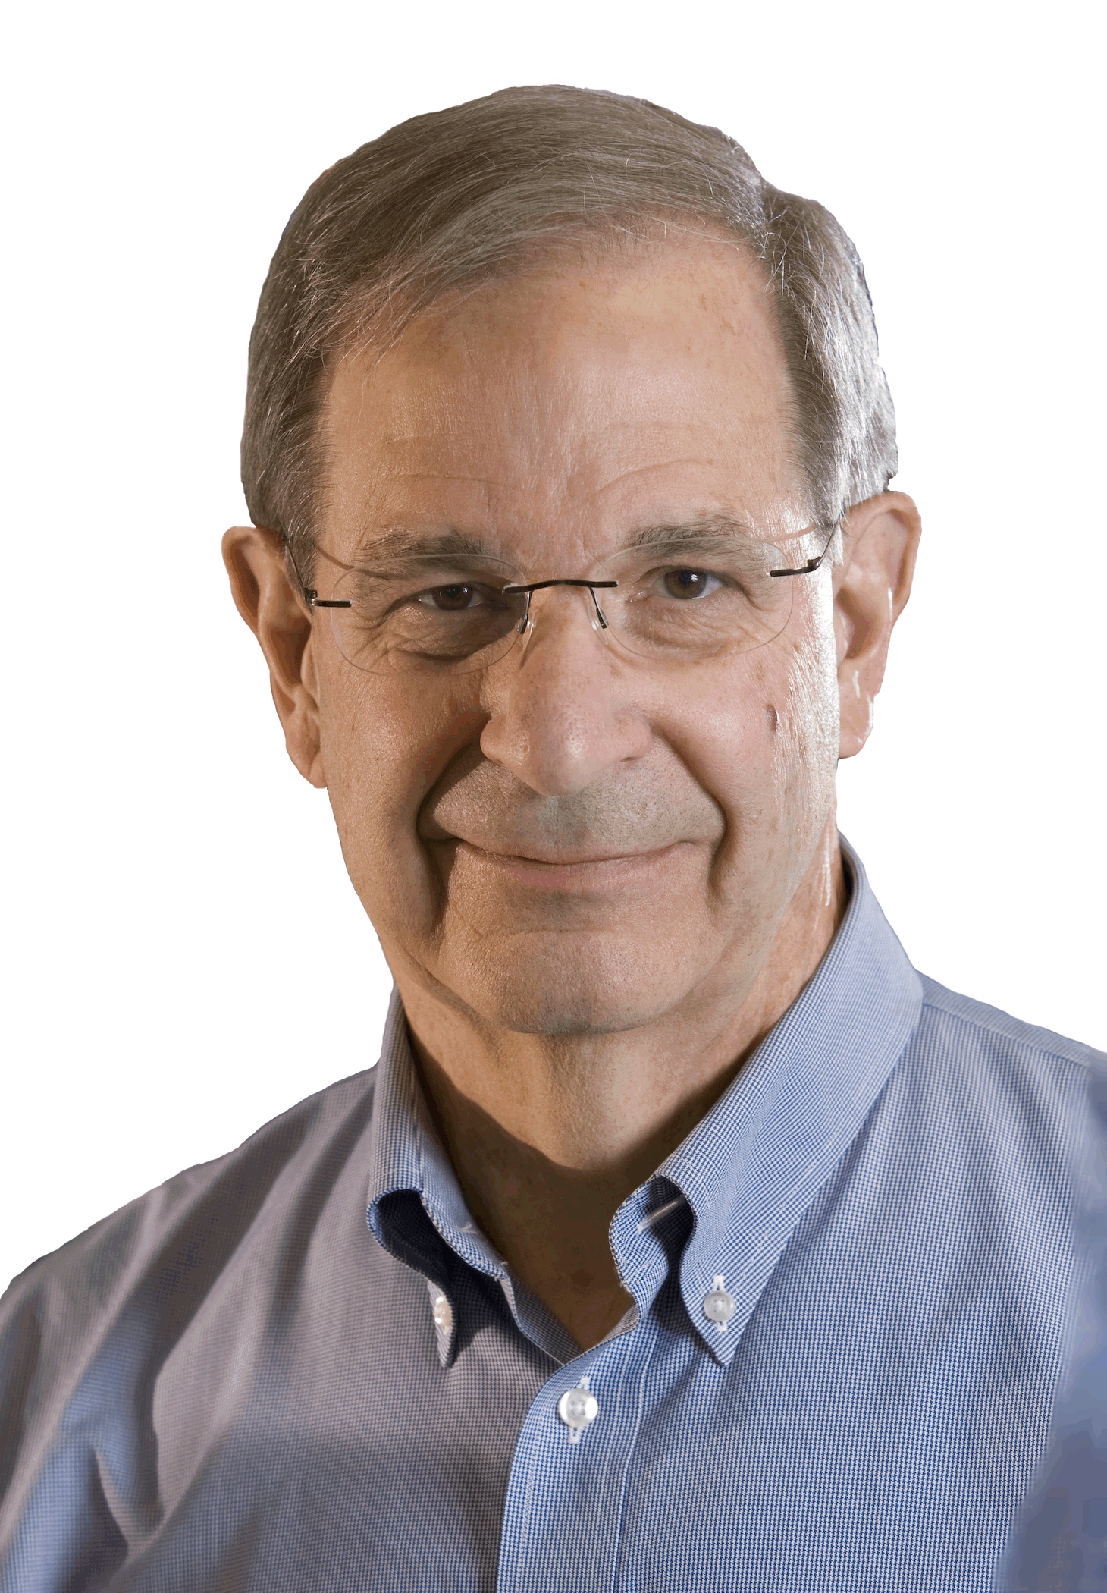
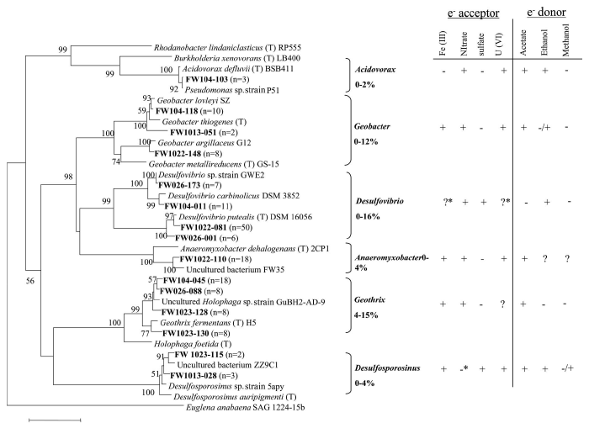
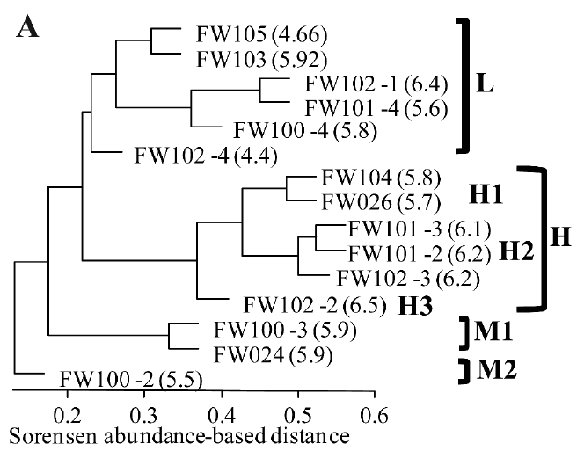

Workshop objectives
Michigan state university
Ph.D. Crop and soil sciences – Environmental toxicology
BS. Biology

Slide 7
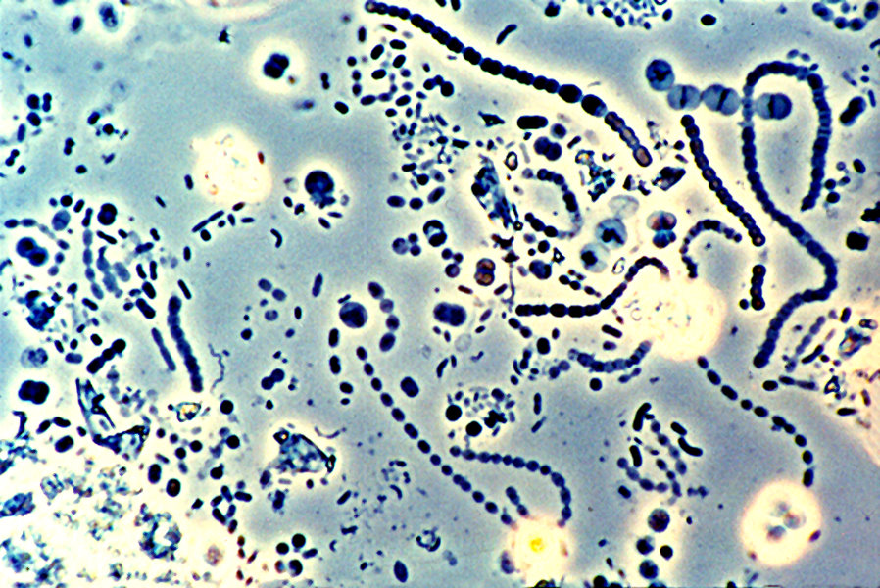
 | V1 | V2 | V3 | V4 | … | VN
Sample 1 | 8 | 0 | 12 | 10 | … | 100
Sample 2 | 3 | 0 | 12 | 40 | … | 0
… | … | … | … | … | … | 45
Sample N | 4 | 1 | 12 | 2 | … | 3
Data processing

Slide 8
Workshop structure
Session 1: Diversity review.
Session 2: How to work with 16S rRNA data.
Session 3: Hands on session with mothur using Miseq data.
Material available at:
https://github.com/carden24/MIC506-Workshop.
Slides.
Files required for computer session.
Other learning resources.

Slide 9
Workshop objectives
By the end of workshop you will be able to:
1.1 Distinguish between alpha and beta diversity.
1.2 Estimate diversity indices.
2.1 Summarize the characteristic of a good phylogenetic marker.
2.2 Explain the concept of operational taxonomic units.
3.1 Complete the Miseq standard operational protocol for Mothur.
3.2 Modify the Mothur script to adapt it to other samples.

Slide 10
Why study microbial communities?

Slide 11
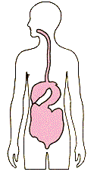
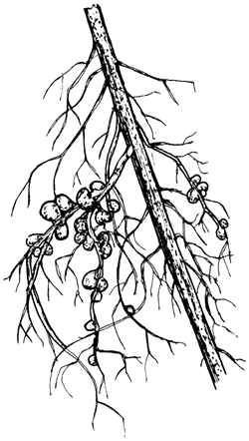
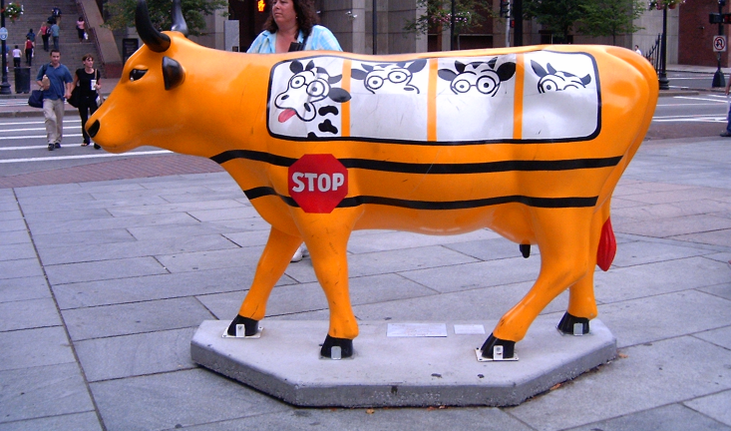
1. Microorganisms have important roles
Important players in biogeochemical cycles (C,N,S, etc.).
Important interactions with other organisms, including humans.
Biotechnological potential.
http://www.fao.org/docrep/006/ad228e/AD228E93.gif

Slide 12
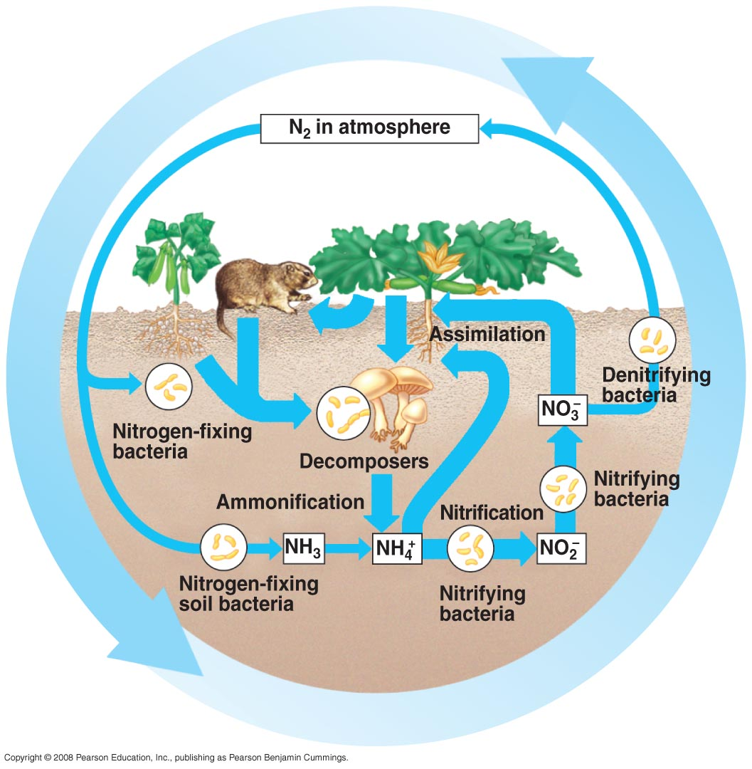
1. Microorganisms have important roles
Important players in biogeochemical cycles
(C,N,S, etc.)
http://apbiosemonefinalreview.pbworks.com/f/55_14cNitrogenCycle-L.jpg

Slide 13
1. Microorganisms have important roles
Important interactions with other organisms, including humans
http://www.fao.org/docrep/006/ad228e/AD228E93.gif

Slide 14
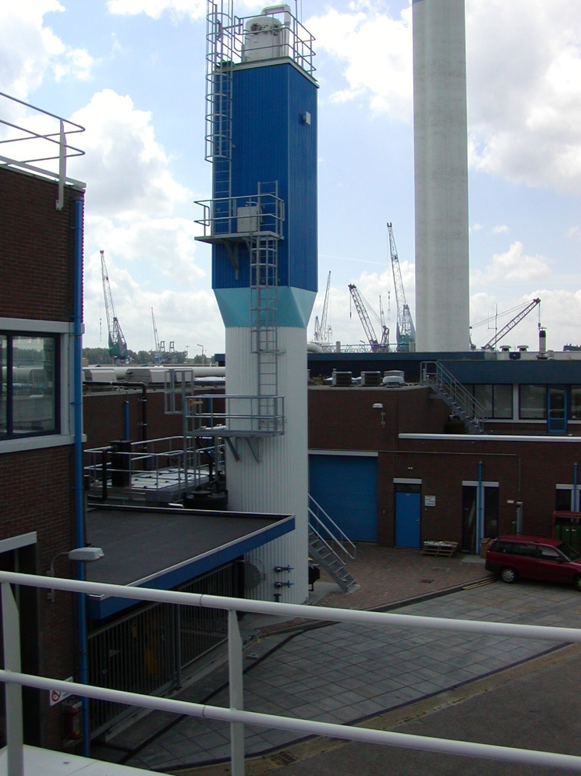
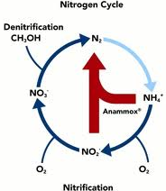
1. Microorganisms have important roles
Biotechnological potential
Wastewater treatment using anaerobic ammonia oxidation.
↓60% energy consumption
↓ 88% CO₂ emmmisions
↓ 50% space use
Anammox bioreacton from: http://www.twanetwerk.nl

Slide 15
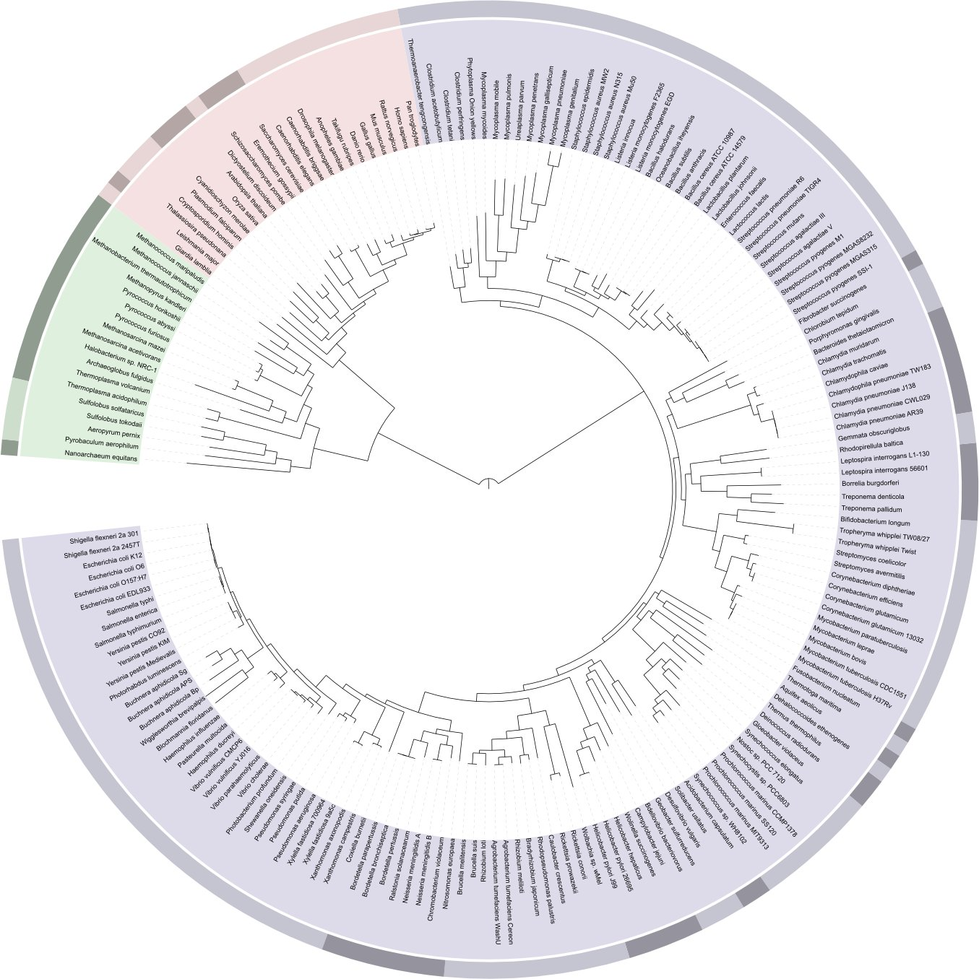
1. Microorganisms have important roles
Highest metabolic and genetic diversity
Humans

Slide 16
2. Sequencing costs have considerably decreased
Data from National Human Genome Research Institute (http://www.genome.gov/sequencingcosts/)

Slide 17
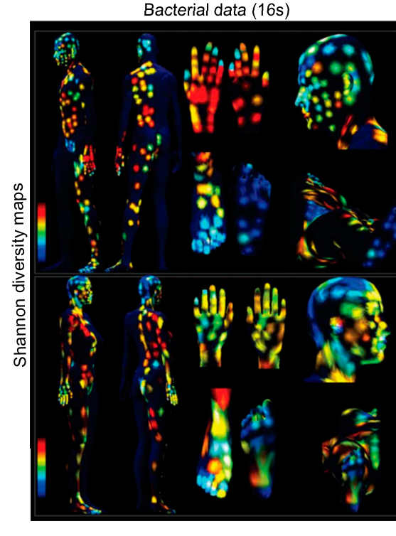
3. We know little about the microorganisms
Most abundant living organisms (4-6 x 10³⁰)
Many unexplored ecosystems
Many unexplored groups
Uncultivated phyla
Archaea
Fungi
PNAS April 28, 2015 vol. 112 no. 17 E2120-E2129
Notes:
In a way, studying the microbial communities will provide information on the ecology of the ecosystem.

Slide 18
What is diversity?

Slide 19
Diversity, definitions
Magurran:
The variety and abundance of species in a defined study unit.
Alpha diversity:
Diversity in a spatial unit
Within community
Beta diversity
A measurement of how two or more spatial units differ
Among communities

Slide 20
Alpha diversity
Richness (S): How many different species exist.
Evenness: Species distribution.
=
>
Richness
Evenness
=
<

Slide 21
Alpha diversity indices
A metric that considers one or more diversity components
Shannon (H’)
Simpson (D)
Chao1

Slide 22
Shannon diversity index (H’)
Number of species
Proportion of the
community contributed by
species i

Slide 23
Shannon’s index limits
Range : 0 - ∞
Heavily influenced by richness

Slide 24
Calculating Shannon’s index
Sample 1
Sample 2
H’= 1.279854
H’=0.940448
 | Count |  | Pi |  | ln(pi) |  | pi.ln(pi)
 | Sample1 | Sample2 | Sample1 | Sample2 | Sample1 | Sample2 | Sample1 | Sample2
Sp1 | 4 | 7 | 0.4 | 0.7 | -0.916 | -0.357 | -0.367 | -0.250
Sp2 | 3 | 1 | 0.3 | 0.1 | -1.204 | -2.300 | -0.361 | -0.230
Sp3 | 2 | 1 | 0.2 | 0.1 | -1.610 | -2.300 | -0.322 | -0.230
Sp4 | 1 | 1 | 0.1 | 0.1 | -2.302 | -2.300 | -0.230 | -0.230
 | 10 | 10 |  |  |  |  | -1.27985 | -0.940

Slide 25
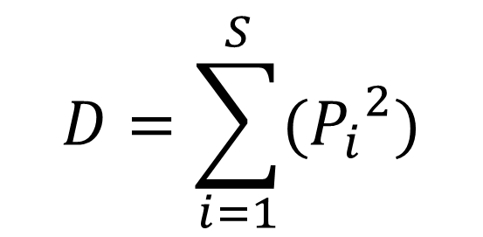
Simpson’s index (D)
Total number
of species
$$D=\sum_{i=1}^{S}{({P_{i}}_{}^{2})}$$
Proportion of the
community contributed
by species i
Probability of selecting the same species when sampling two members at random the same

Slide 26
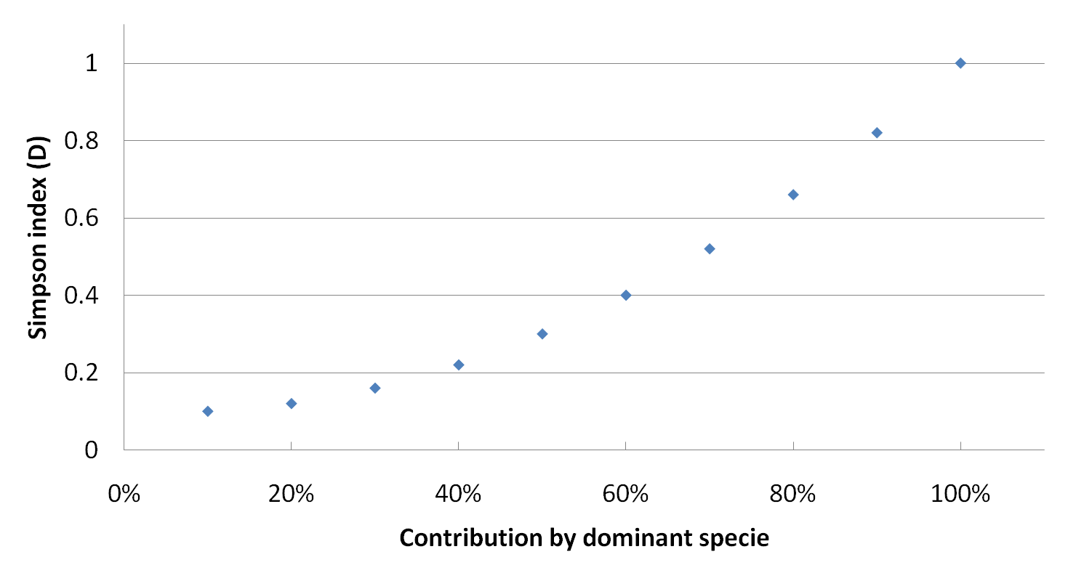
Simpson’s index (D)
Range : < 0 – 1 ]
Strongly influenced by evenness.
Usually expressed as (1-D) - more intuitive.
Contribution by dominant species

Slide 27
Calculating Simpson’s index
Sample 1
Sample 2
D = 0.3
1-D = 0.7
D = 0.52
1-D = 0.48
 | Count |  | Pi |  | Pi2
 | Sample1 | Sample2 | Sample1 | Sample2 | Sample1 | Sample2
Sp1 | 4 | 7 | 0.4 | 0.7 | 0.16 | 0.49
Sp2 | 3 | 1 | 0.3 | 0.1 | 0.09 | 0.01
Sp3 | 2 | 1 | 0.2 | 0.1 | 0.04 | 0.01
Sp4 | 1 | 1 | 0.1 | 0.1 | 0.01 | 0.01
 | 10 | 10 |  |  | 0.3 | 0.52

Slide 28
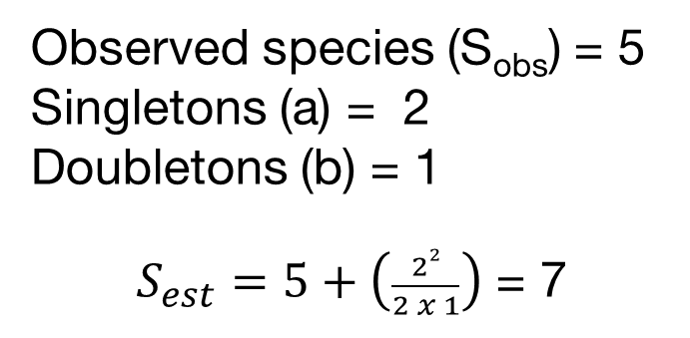
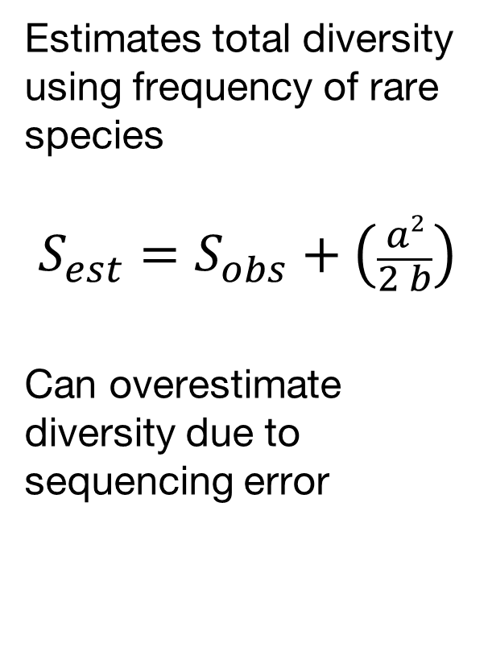
Chao1index
Estimates total diversity using frequency of rare species
$$S_{est}=S_{obs}+\left(\frac{a2}{2 b}\right)$$
Can overestimate diversity due to sequencing error
Observed species (S_{obs}) = 5
Singletons (a) = 2
Doubletons (b) = 1
$S_{est}=5+\left(\frac{22}{2 x 1}\right)$ = 7

Slide 29
Simpson evenness index
(1/D)
Limits 1/S - S
Dominant species contribution

Slide 30
Rank-Abundance curves
Show both richness and evenness
Steep slopes suggest strong selective pressure
Curves can indicate distribution of resources
Species in order of abundance

Slide 31
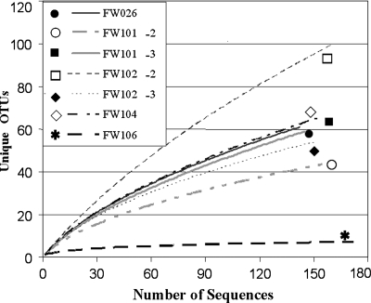
Rarefaction curves
Used to compare diversity when sampling was done at different levels.
Sometimes used to estimate if coverage has reached a plateau.
Are only informative when saturated.

Slide 32
Diversity, definitions
Magurran:
The variety and abundance of species in a defined study unit.
Alpha diversity:
Diversity in a spatial unit
Within community
Beta diversity
A measurement of how two or more spatial units differ
Among communities

Slide 33
How similar are these communities?
 | Sp1 | Sp2 | Sp3 | Sp4 | Sp5 | Sp6
Sample1 | 8 | 0 | 12 | 10 | 1 | 100
Sample2 | 3 | 0 | 12 | 40 | 5 | 0
Sample3 | 10 | 0 | 12 | 10 | 11 | 15
Sample4 | 4 | 1 | 12 | 2 | 8 | 3

Slide 34
Beta diversity indices
Quantify diversity among communities
Range: 0 – 1
0 = 100% similarity, 0% distance
1 = 0% similarity, 100% distance
Can use abundance and occurrence
Commonly used indices
Jaccard (Occ.)
Sørensen (Occ.)
Bray-Curtis (Occ. + Ab.)
Chao-Sørensen (Occ. + Ab.)

Slide 35
Presence/absences indices
a
b
c
Sample 1
Sample 2
Jaccard = b / (a+b+c)
Sorensen (QS) = 2b /(a+2b+c))
More weight to shared species

Slide 36
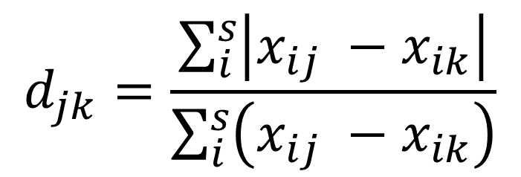
Indices using both abundance and occurrence
Bray -Curtis
Chao-Sorensen
Considers both abundance and assumes suboptimal sampling.
Absolute differences in abundance for i in samples j and k
$$d_{jk}=\frac{\sum_{i}^{s}{\left|x_{ij} −x_{ik}\right|}}{\sum_{i}^{s}{\left(x_{ij} −x_{ik}\right)}}$$
Sum of abundance for
i in samples j and k

Slide 37
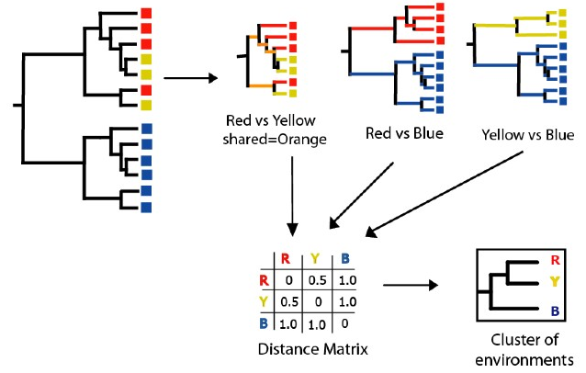
Tree-based indices
UNIFRAC
Based on phylogenetic diversity.
Useful when comparing very different environments with not many common species.

Slide 38
How to present beta diversity
 | OTU1 | OTU2 | OTU3 | OTU4 | OTU5
Sample1 | 20 | 15 | 50 | 10 | 0
Sample2 | 15 | 30 | 35 | 20 | 0
Sample3 | 0 | 12 | 0 | 100 | 0
Sample4 | 0 | 10 | 100 | 0 | 1
Create a table:
Samples (rows)
x Species (cols)
Create a
Distance matrix
0.32
Sample 4
0.16
Coordinate 2
Sample 3
 | Sample1 | Sample2 | Sample3 | Sample4
Sample1 | 0.000 | 0.231 | 0.787 | 0.417
Sample2 | 0.231 | 0.000 | 0.698 | 0.573
Sample3 | 0.787 | 0.698 | 0.000 | 0.910
Sample4 | 0.417 | 0.573 | 0.910 | 0.00
0.00
Sample 1
-0.16
-0.32
Sample 2
-0.80
-0.48
-0.16
0.16
0.48
Coordinate 1
Sample 4
Sample 2
Sample 1
Create a clustering tree or ordination
Sample 3
0.2
0.3
0.4
0.5
0.6
0.7
0.8
0.9
1.0
Bray-Curtis similarity

Slide 39
Now some examples…

Slide 40
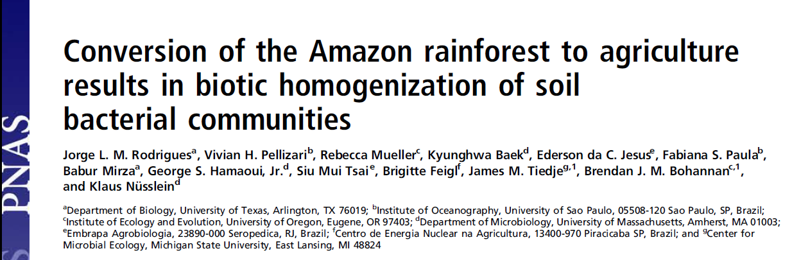
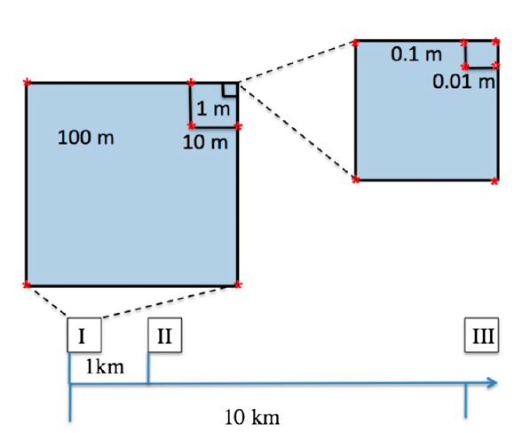
Nested blocks design
Natural forest converted to pastures
Diversity analysis of 16S rRNA data using 454 data with MOTHUR and RDP

Slide 41
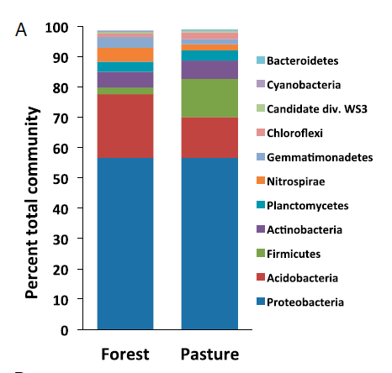
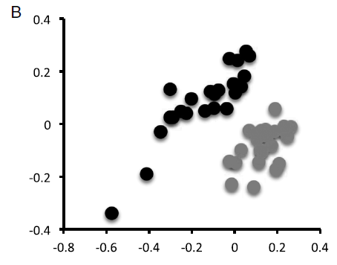
Conversion to agriculture affects the community composition
Forest
Pasture
Classification using representative sequences
NMDS using
Bray-Curtis distances
Notes:
Is this a alpha or beta diversity analysis?

Slide 42
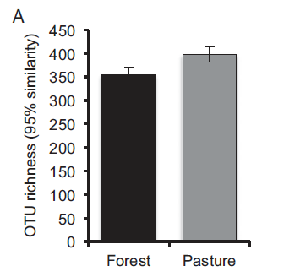
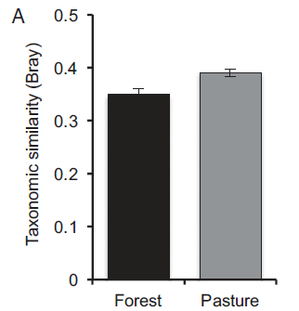
Conversion increases the communities’ diversity
Alpha diversity changes
Beta diversity changes
Notes:
Is this a alpha or beta diversity analysis?

Slide 43
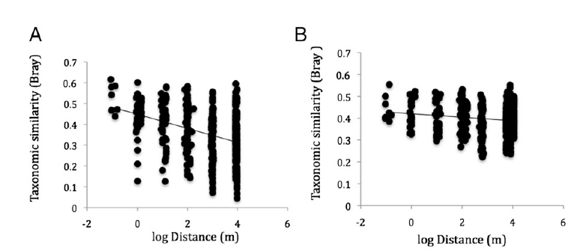
Conversion to agriculture homogenizes the communities
Forest
Pasture
Notes:
Is this a alpha or beta diversity analysis?

Slide 44
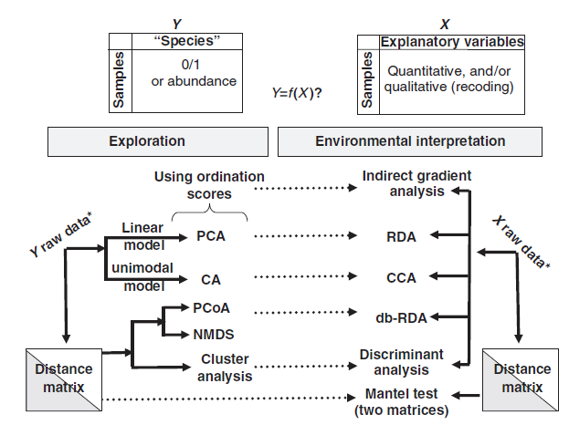
But wait, there is more…

Slide 45
Resources
Multivariate analysis in microbial ecology [Minireview].
Tree diversity analysis [Book]. (Free, includes R codes).
Available at the workshop repository.
https://github.com/carden24/MIC506-Workshop

Slide 46
Diversity - Summary
The variety and abundance of species in a defined study unit.
Alpha
Within a community (Species diversity in a site or habitat)
Richness, evenness
Chao1, Simpson, Shannon Index
Beta
Among communities (Differentiation of habitats)
Sorensen, Jaccard, Bray-Curtis, Unifrac
Clustering, ordination

